Slide 1
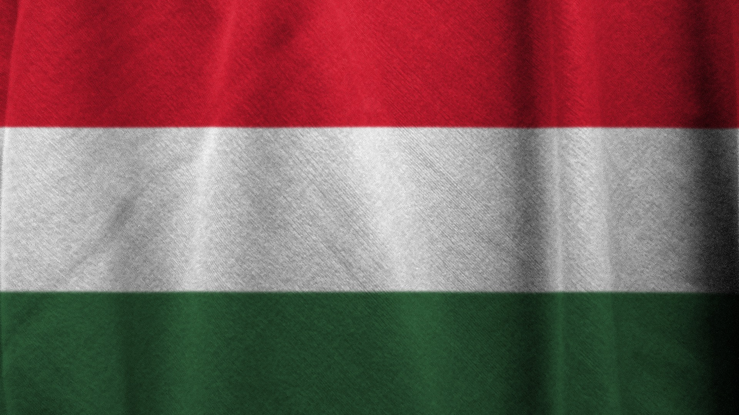

Hungary

Slide 2
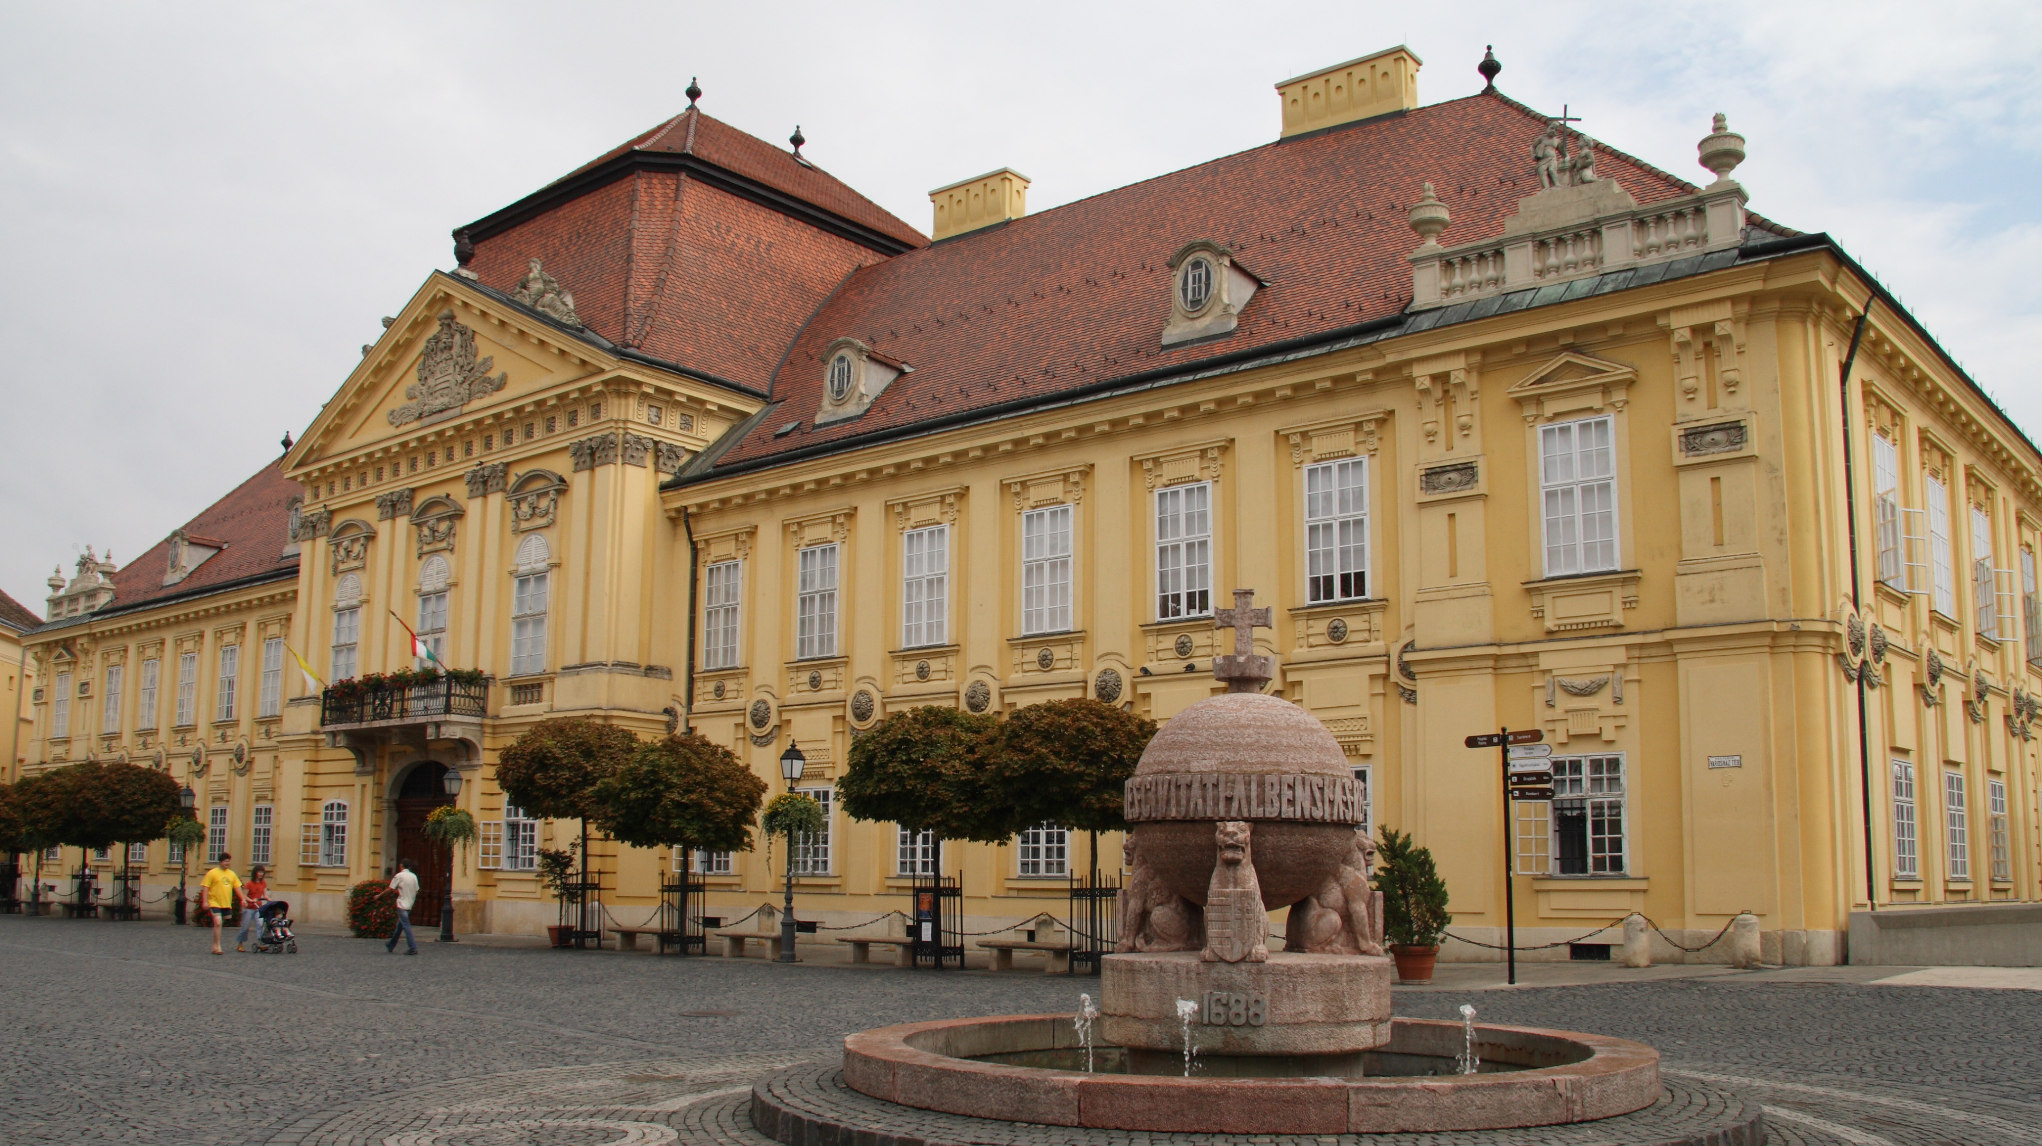
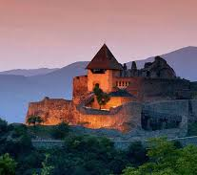
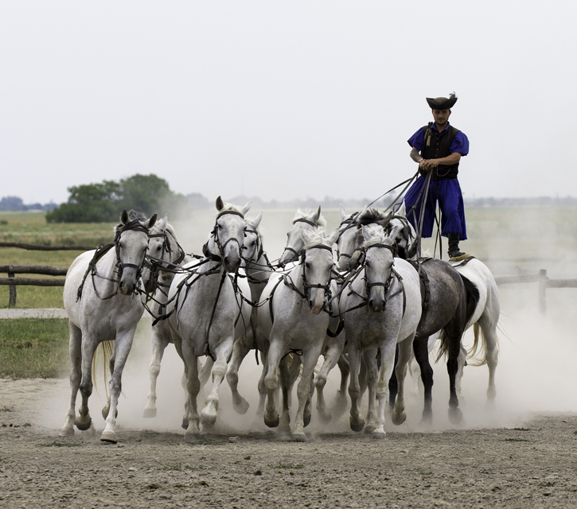
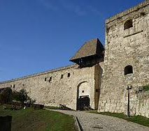
Hungary
It’s a small country in Central Europe. Its population is about 10 million people and the official language is Hungarian.

Slide 3
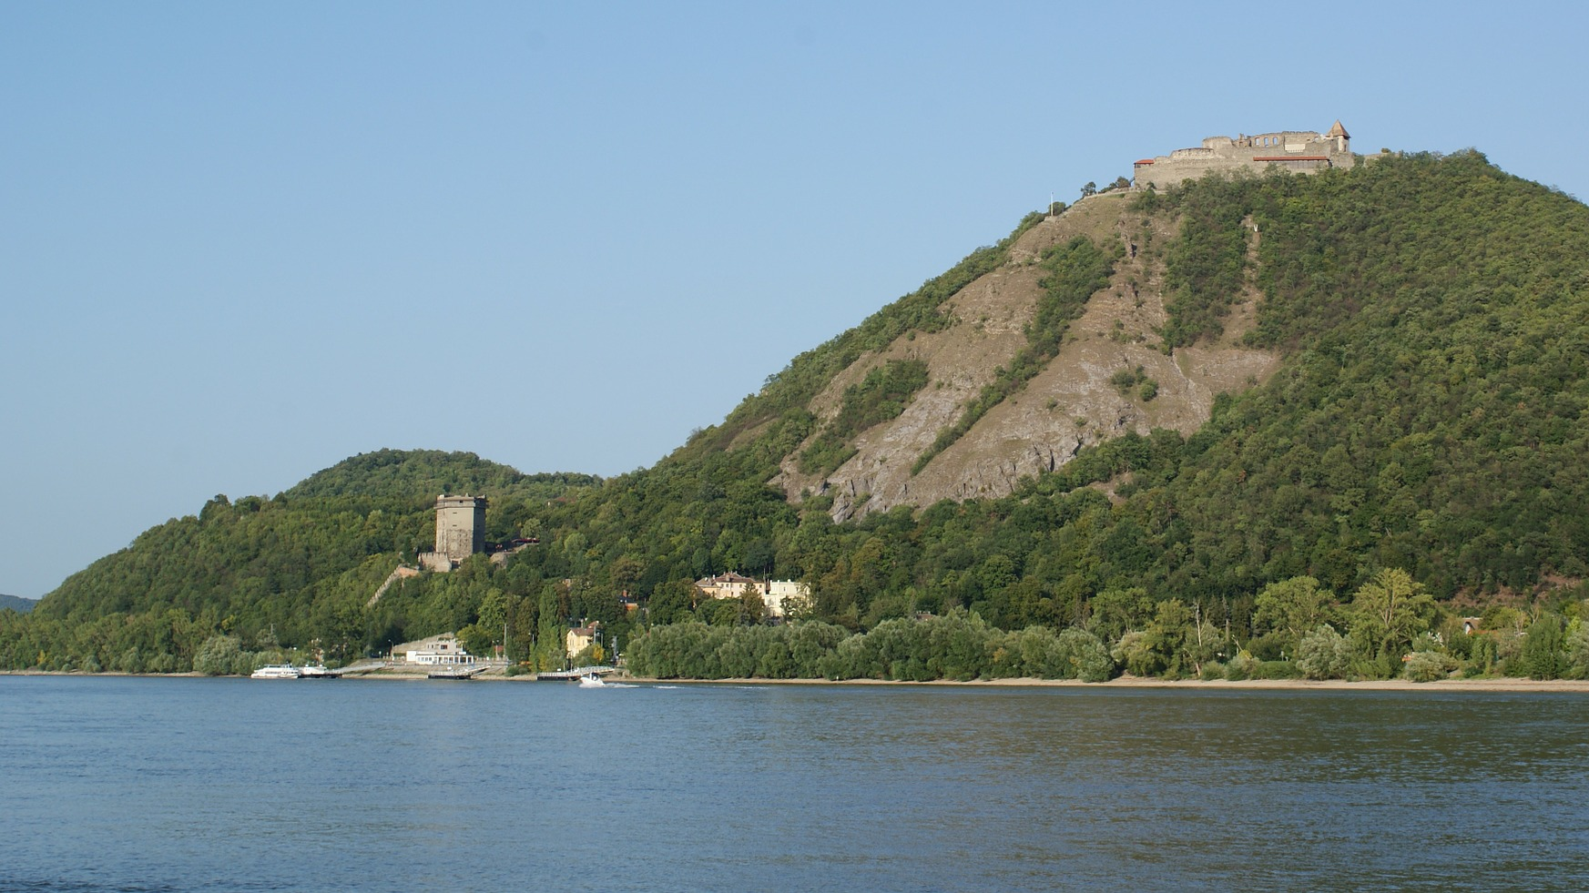
Visegrád castle
The highest mountain is the Kékes in the Mátra Hills. It’s 1014m high.
The largest river is the Danube and the second largest is the river Tisza.
The biggest lake is lake Balaton. It’s the largest lake in Central Europe and the third largest lake in the continent.

Slide 4
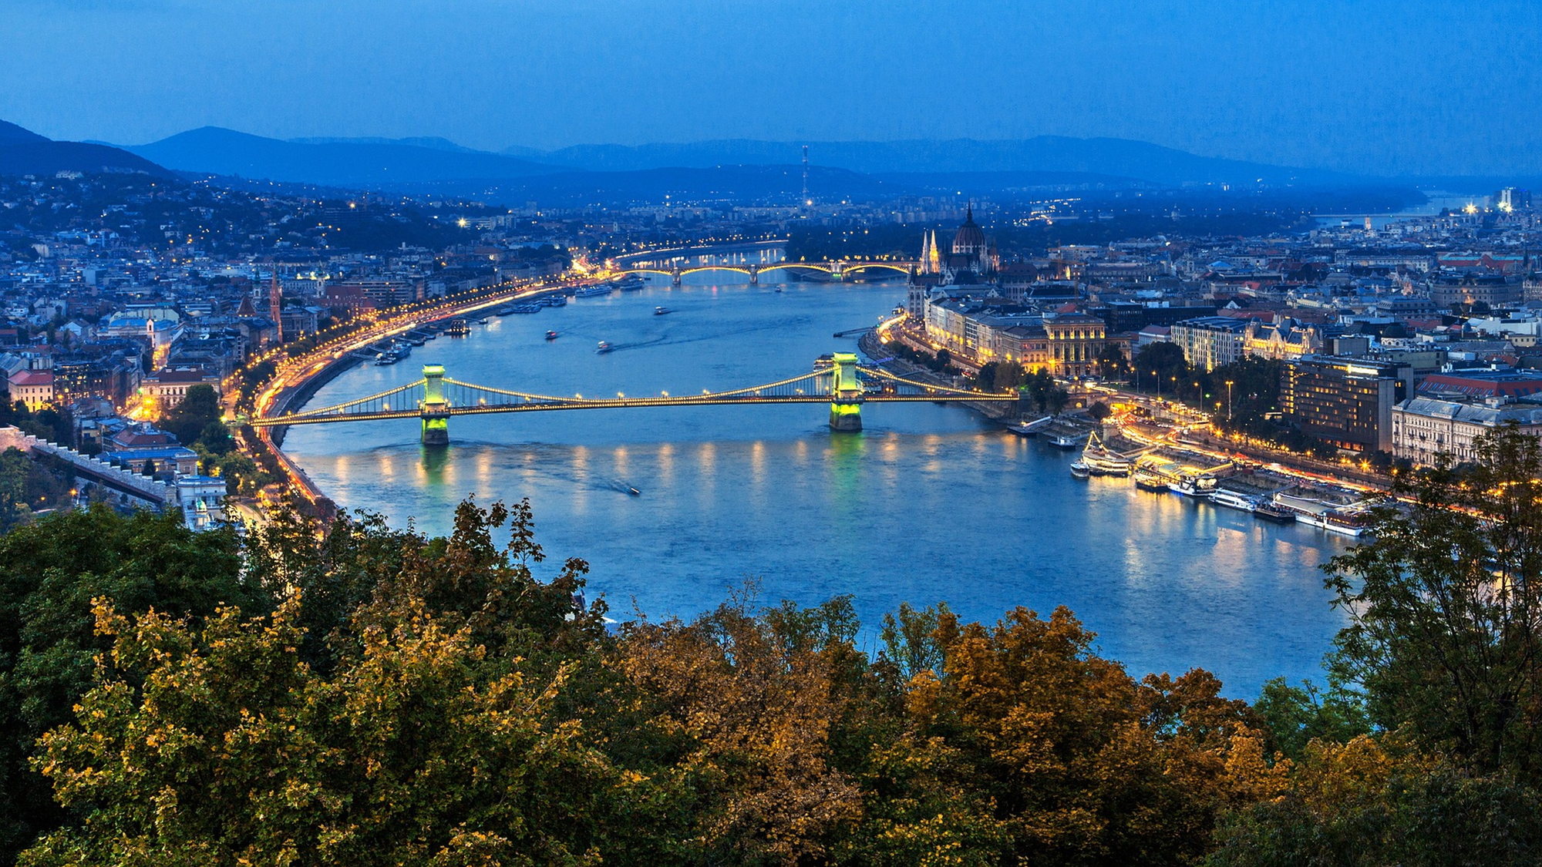
Budapest
The capital city is Budapest.
About two million people live there.

Slide 5
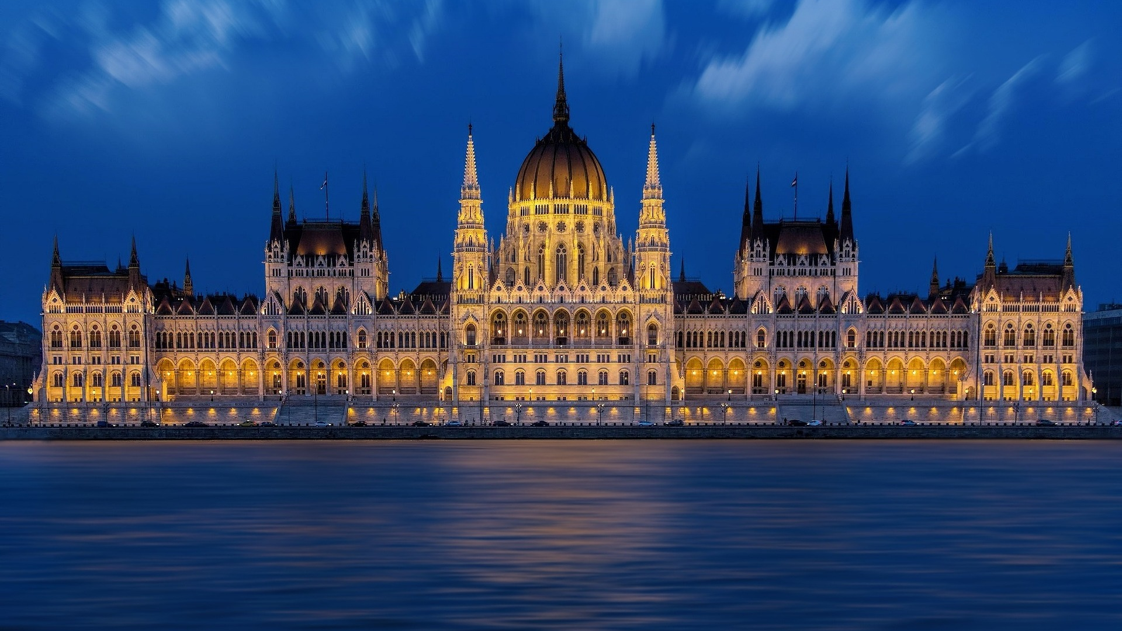
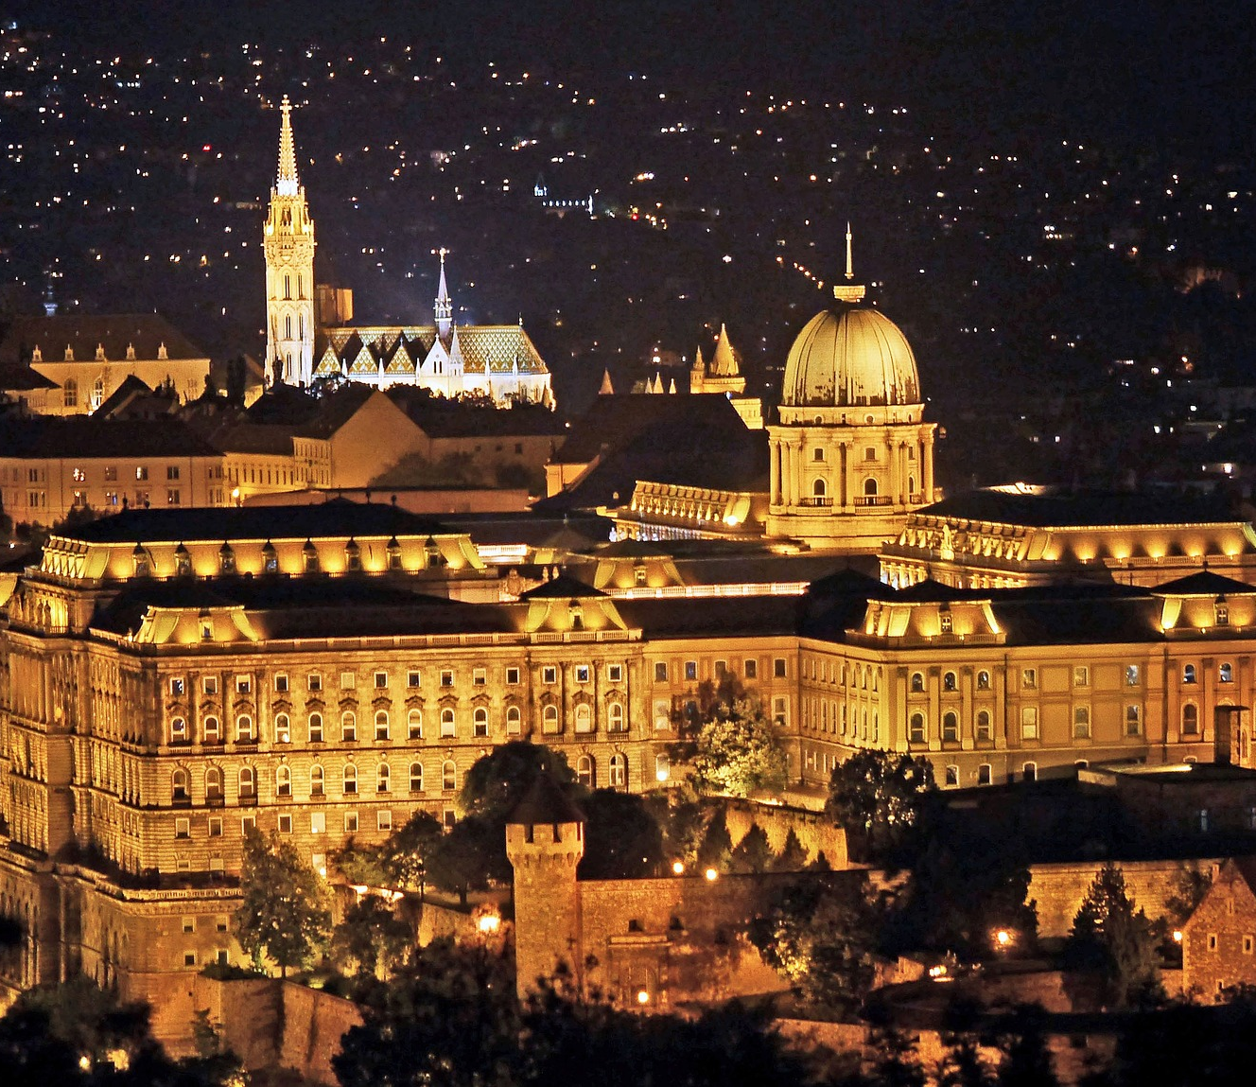
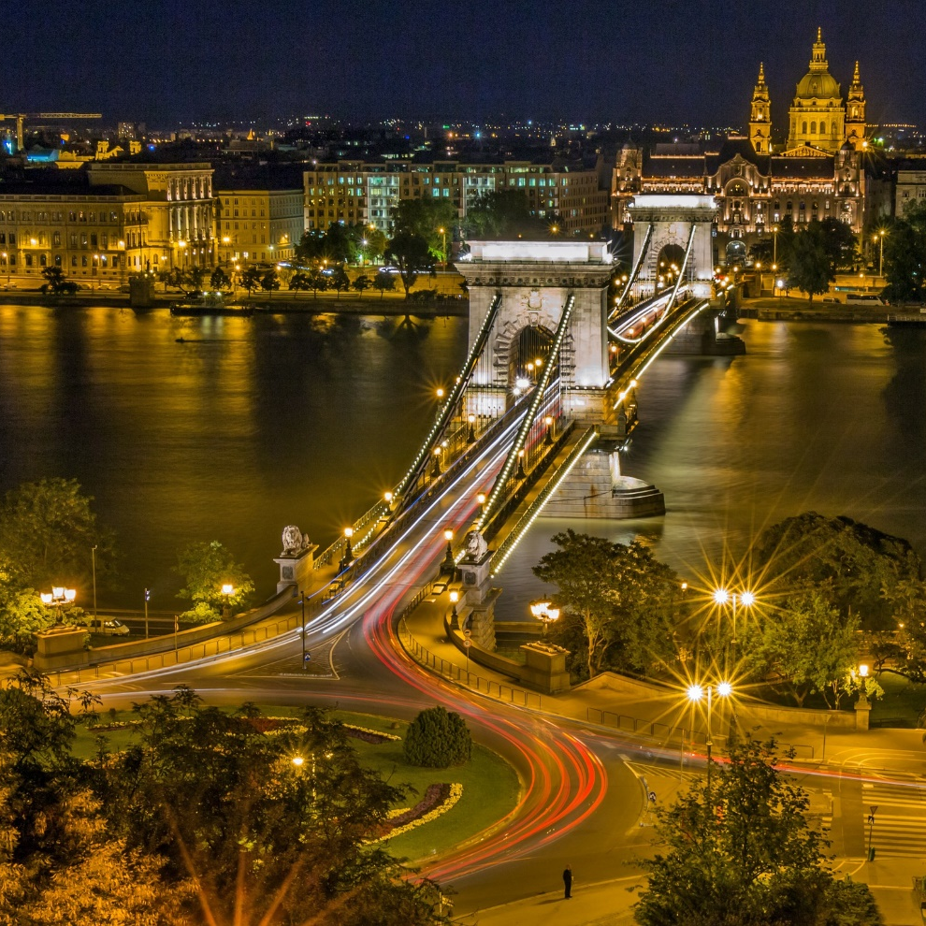
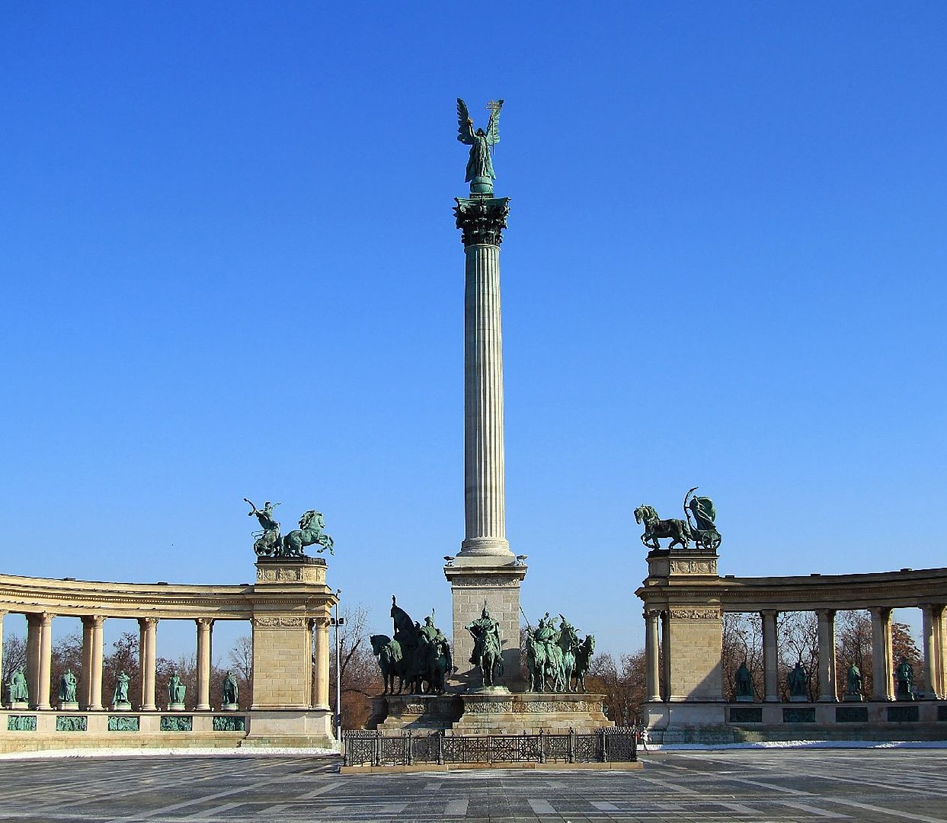
Budapest
Famous places in Budapest:
Hungarian Parliament Building
Heroes’ square
Chain Bridge
Buda castle

Slide 6
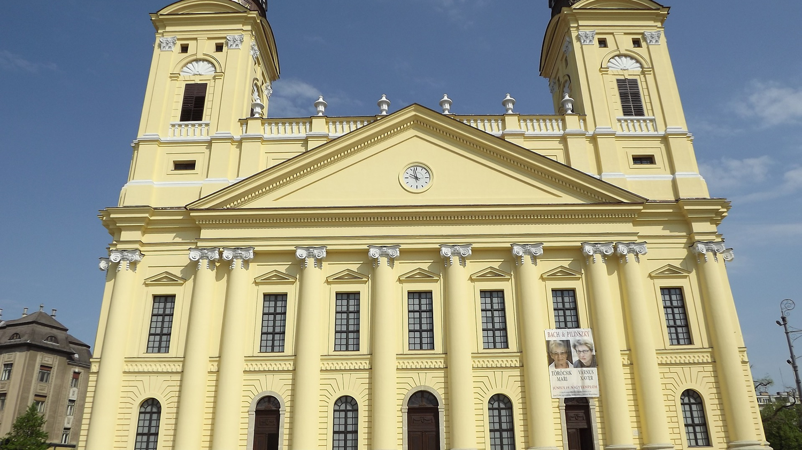
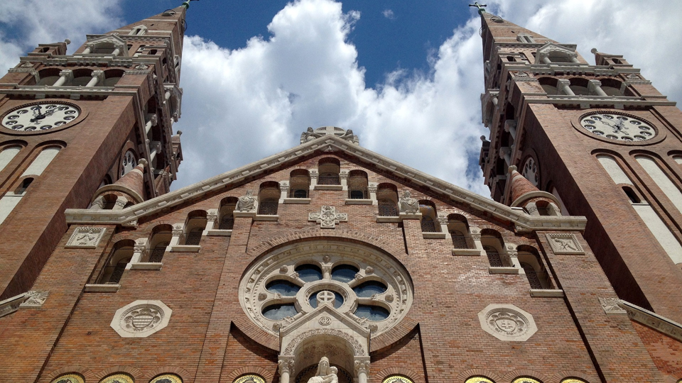
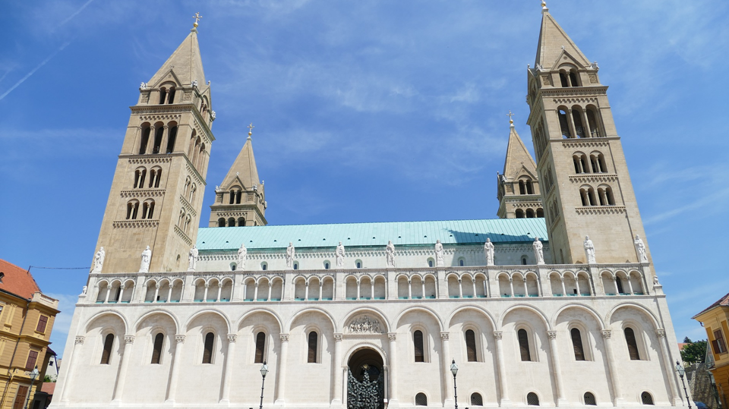
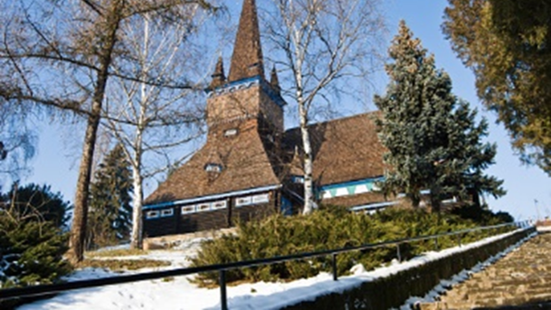
Other big cities
Debrecen
Szeged
Pécs
Miskolc

Slide 7
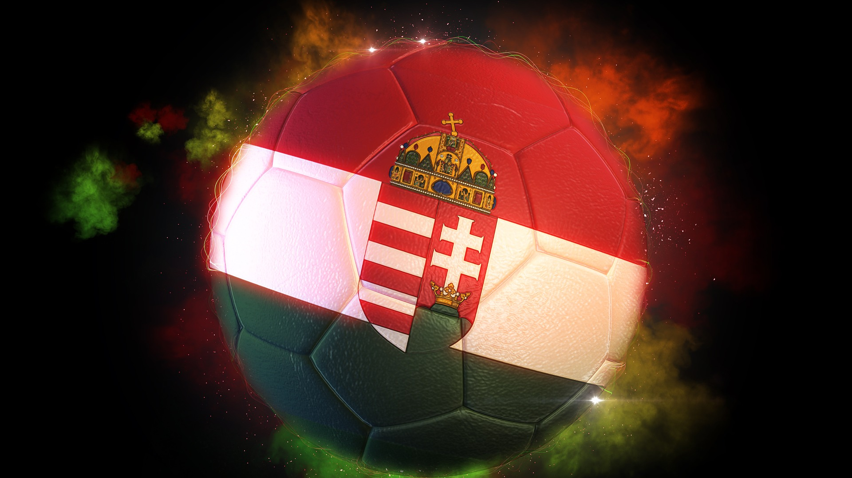
Sports
The most popular sport is football.
The Hungarians are good at handball, waterpolo, ice hockey, swimming and canoeing.

Slide 8
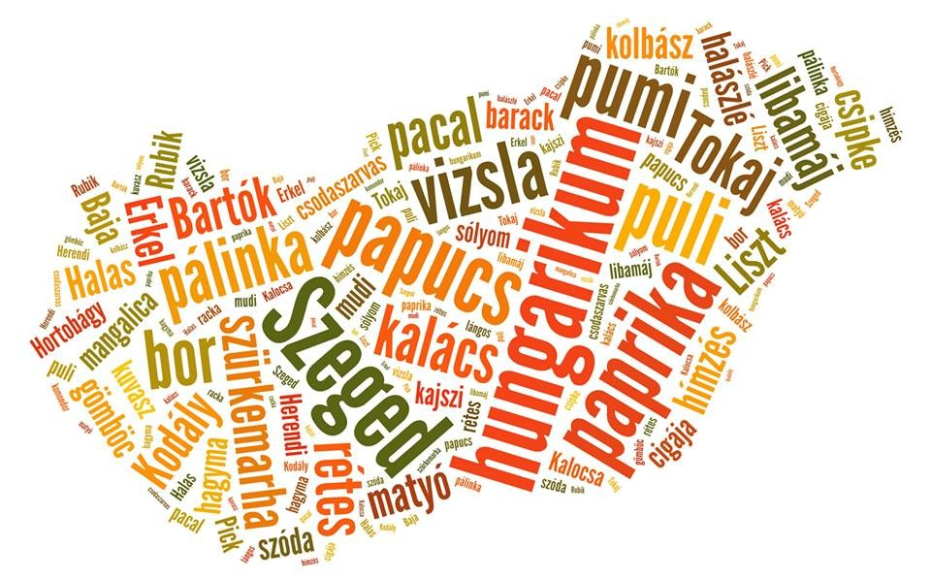
Hungaricums
Hungaricums are traditional Hungarian things.
There are 75 Hungaricums.

Slide 9
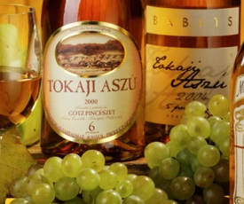
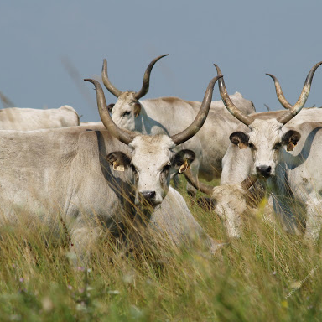
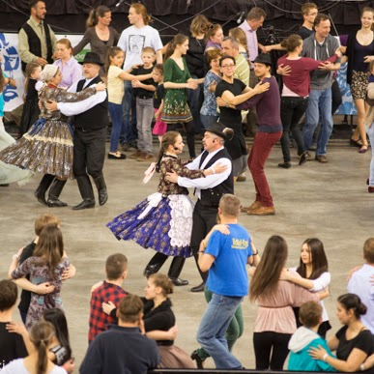
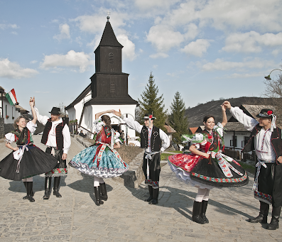
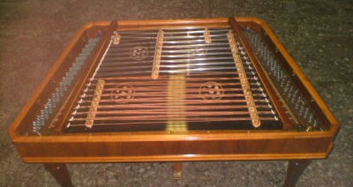
Some Hungaricums
Tokaji Aszú
Hungarian grey cattle
Makó onion
Hollókő old village
Dance house movement
Hungarian cimbalo

Slide 10
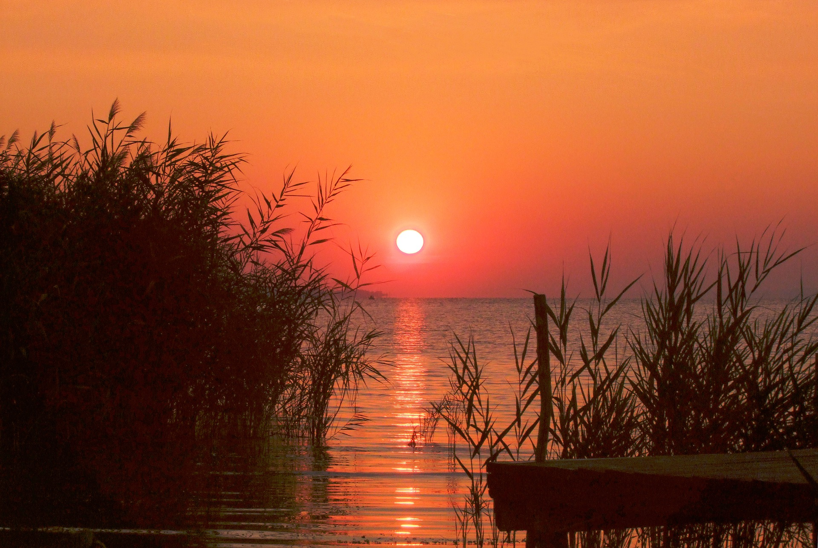
Thank you for your attention!
Music by Szászcsávás Band
Pictures: Pixabay.com
Created by: Péter Imre Pintér
The end!

