Slide 1
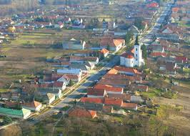
PÁZMÁND Hungary
our village
Made by Zsombor Zámbó

Slide 2
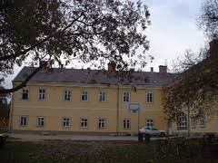
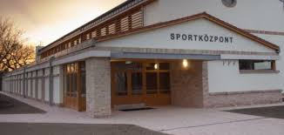
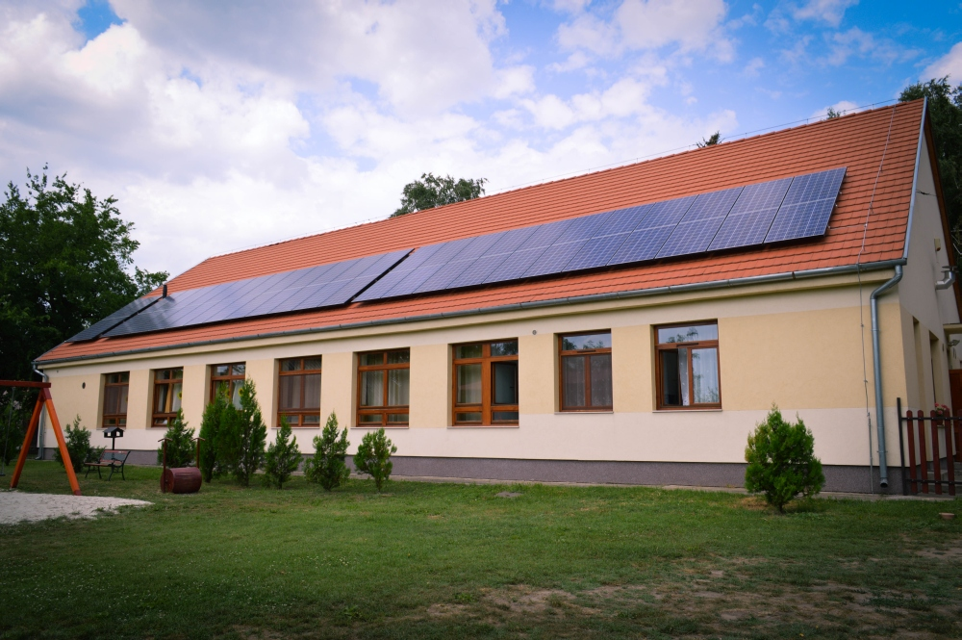
This is our school, it used to be a castle
This is the sport centre. It is next to the school.
This is the kindergarten. This is next to the sport centre

Slide 3
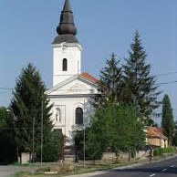
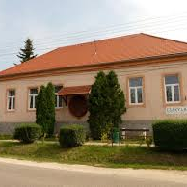
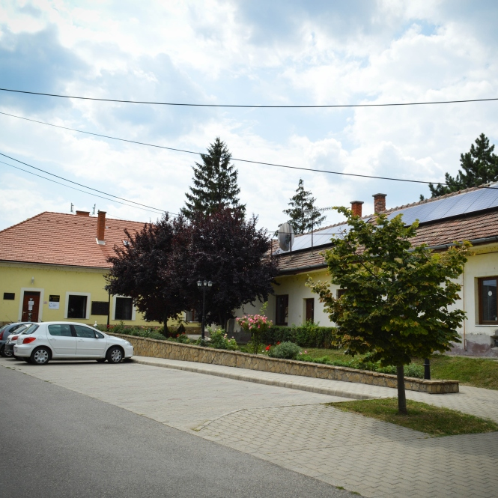
The church is old, built in the eighteenth century.
Here is the libray
It is the village hall

Slide 4
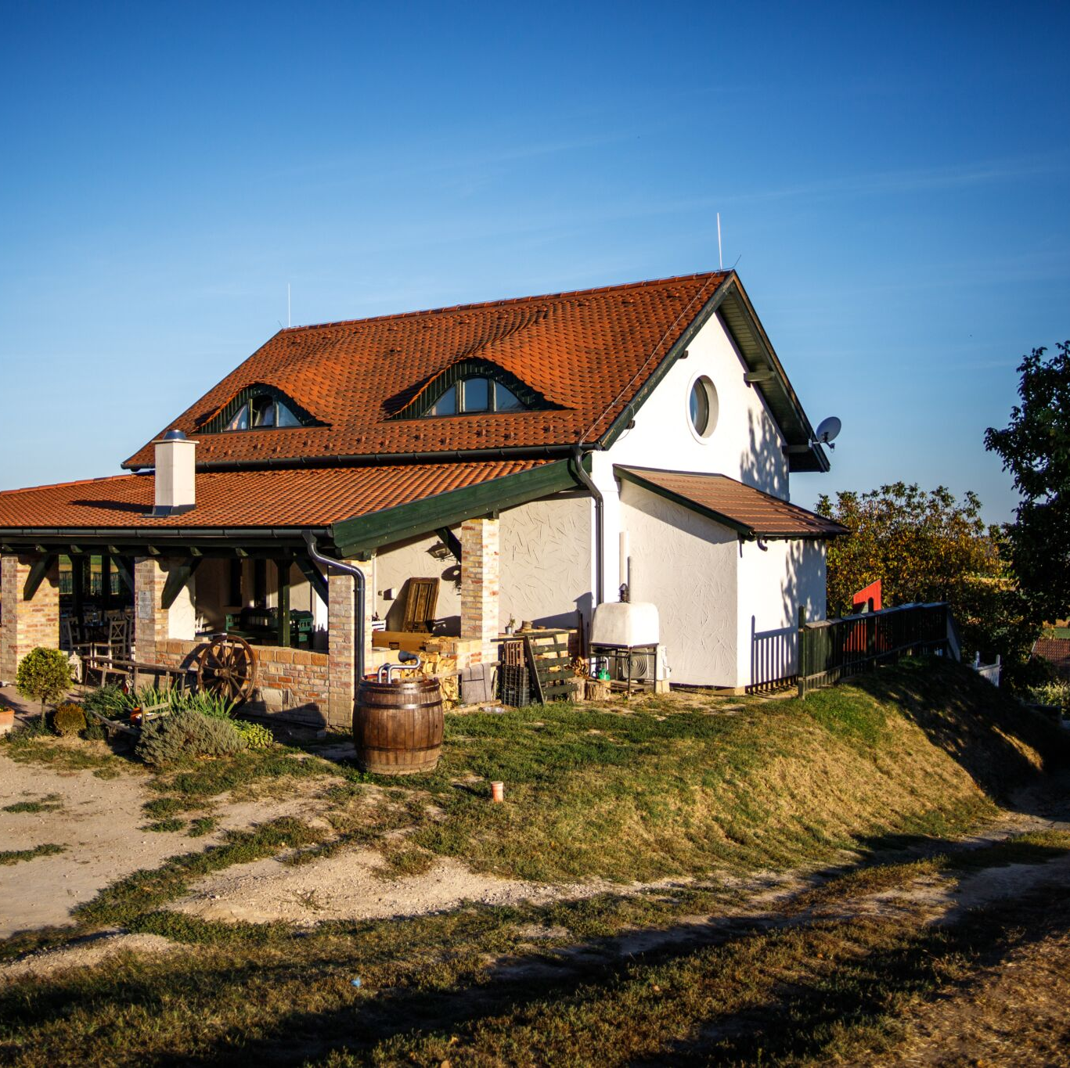
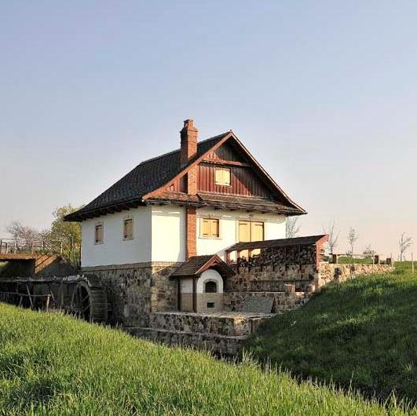
This is a restaurant on the hill. Weddings are also held here.
This is a water mill, it is next to the village

Slide 5
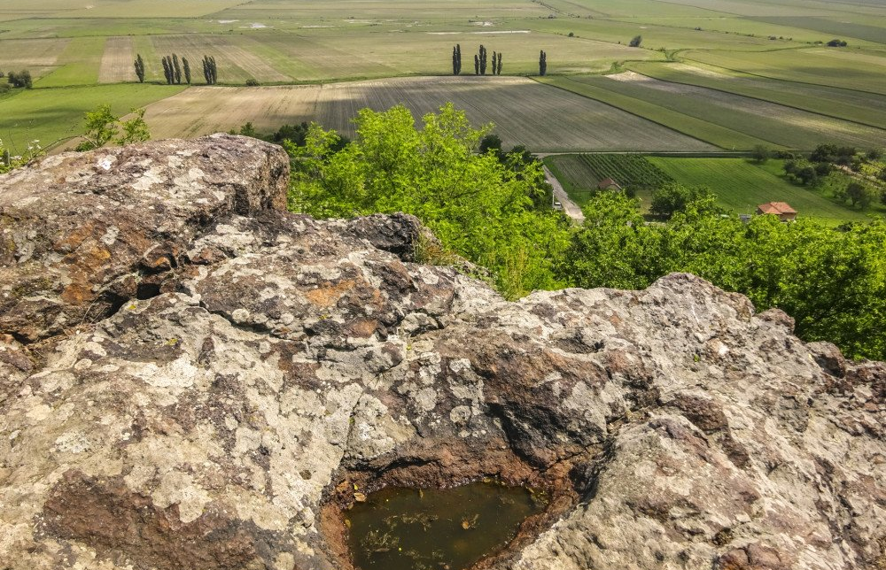
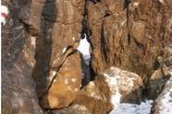
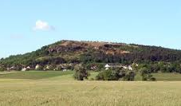
Szöveg beírásához kattintson ide
This is Zsidókő hill – You can have a nice view of the village from the top.

Slide 6
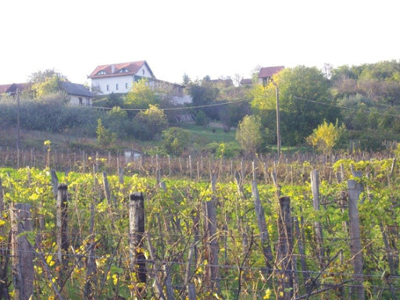
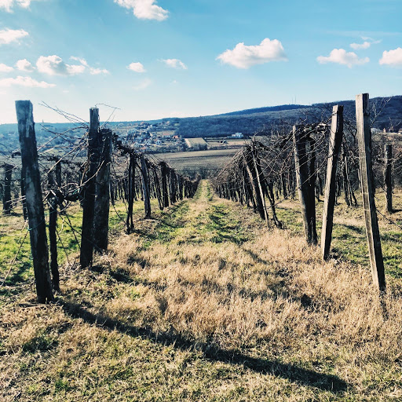
The vineyards in Pázmánd. Our village is famous for its wine.

